Slide 1



NETFLIX Data
SQL Analysis
SUBTITLE HERE

Slide 2
Project Overview
SQL-based analysis of Netflix dataset
Focus on Movies, TV Shows, Genres, Ratings, Countries, Actors
01
02
03
04
Answered 15 real-world business questions
Useful for streaming platforms, analysts & strategists

Slide 3
Dataset Used
1
3
show_id, type, title, director, casts
rating, duration, listed_in, description
Table Name: netflix
Key Columns:
2
4
0
country, date_added, release_year
Source: Single Excel dataset → imported into PostgreSQL
01
02
03

Slide 4
Project Objectives
Compare Movies vs TV Shows count
Identify top actors & directors
Study ratings & audience segmentation
Analyze country-wise distribution
Track yearly release trends (India focus)
Detect violent/sensitive content patterns

Slide 5



Business Problems Addressed (Part 1)
2025
2025
2025
2025
2025
How many Movies vs TV Shows exist?
What’s the most common rating?
Which year had the highest releases?
Top 5 countries producing Netflix content?
Which are the longest movies?

Slide 6

Business Problems Addressed (Part 2)
Content added in last 5 years
Which directors have the most shows?
TV shows with more than 5 seasons
Which genres dominate Netflix?
Netflix content from India (trends by year)
Actor insights (Salman Khan + Top 10 Indian actors)
Content flagged as Good vs Bad (violence)
01
02
NETFLIX
03
04

Slide 7
Methodology
Steps followed:
1
Data Preparation – Import Excel → PostgreSQL, assign data types
2
Basic Exploration – SELECT, DISTINCT, WHERE
3
Advanced Analysis – Aggregations, Date filters, Text search
4
Array Handling – UNNEST, STRING_TO_ARRAY for actors/genres

Slide 8
Key Insights
1
2
3
4
Movies dominate over TV Shows
Most common rating = TV-MA (mature audience)
Top producing countries = USA, India
Longest movie identified by runtime field
5
5
6
7
8
Recent years = steady content growth
Top Indian actors frequently featured
Salman Khan appeared in multiple movies (last 10 years)
Genres: Drama, Comedy, International Movies dominate
Categorization: Good vs Bad (Violent content detection)

Slide 9
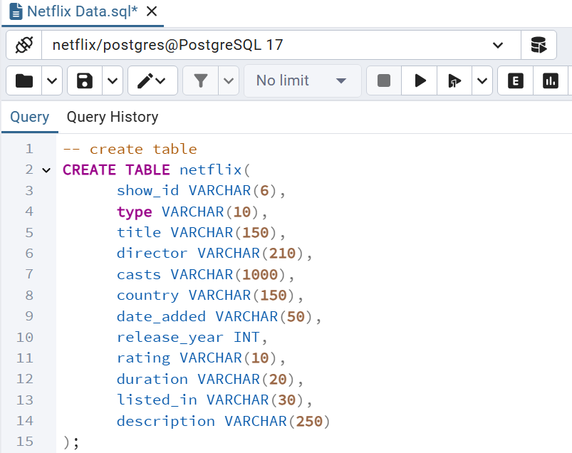
Sample SQL Table
Detailed text descriptions are added here, which are relevant to the title and consistent with the overall language style.

Slide 10
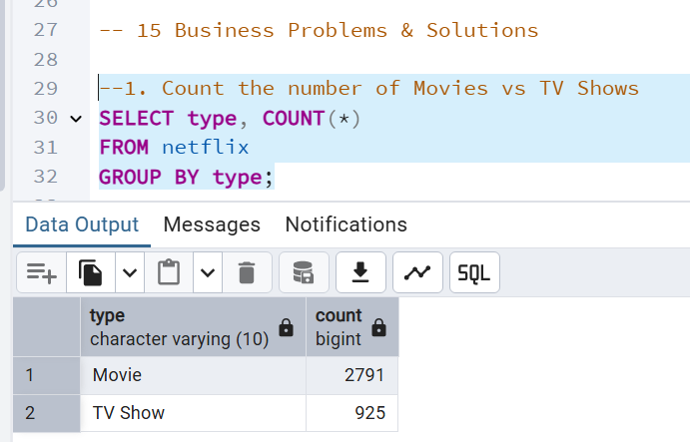
Sample Queries
--1. Count the number of Movies vs TV Shows
SELECT type, COUNT(*)
FROM netflix
GROUP BY type;

Slide 11
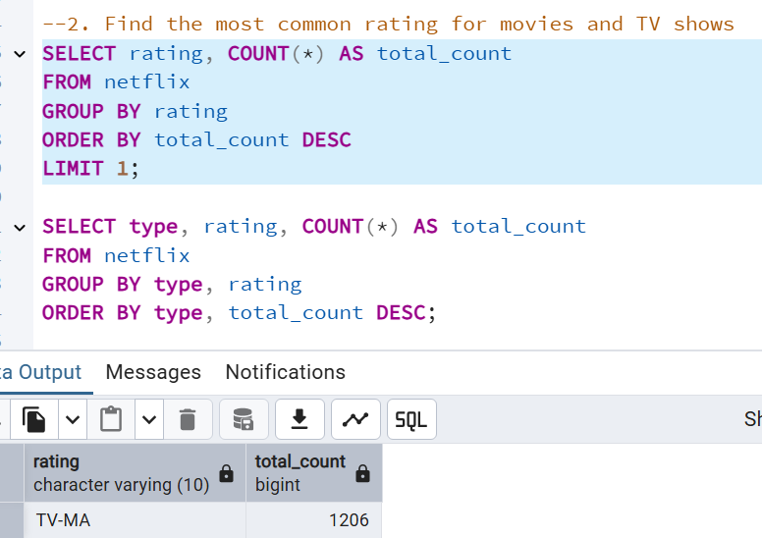
Sample Queries
--2. Find the most common rating for movies and TV shows
SELECT rating, COUNT(*) AS total_count
FROM netflix
GROUP BY rating
ORDER BY total_count DESC
LIMIT 1;
SELECT type, rating, COUNT(*) AS total_count
FROM netflix
GROUP BY type, rating
ORDER BY type, total_count DESC;

Slide 12
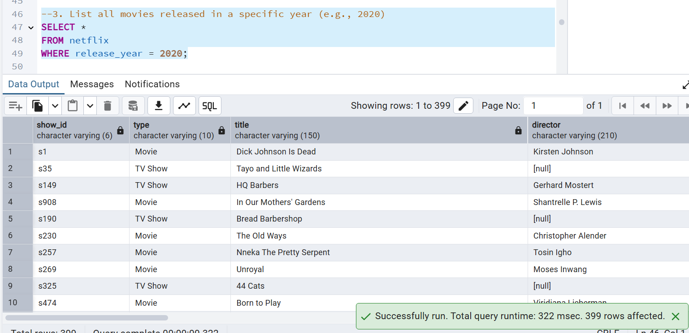
Sample Queries
--3. List all movies released in a specific year (e.g., 2020)
SELECT *
FROM netflix
WHERE release_year = 2020;

Slide 13
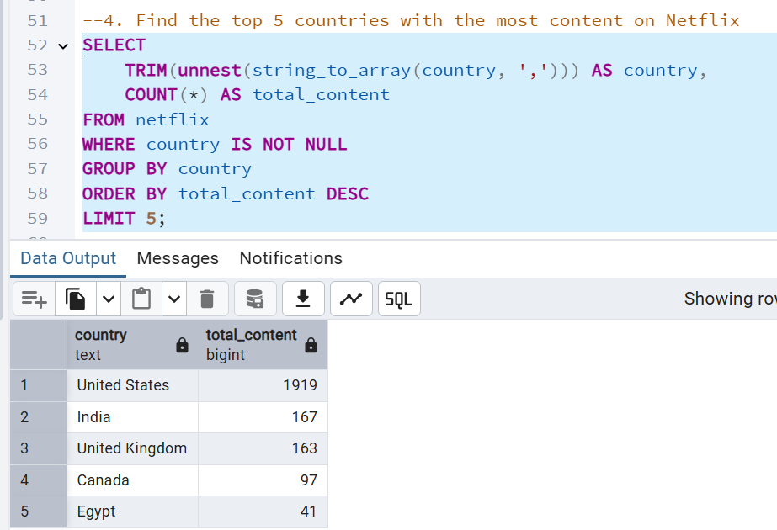
Sample Queries
--4. Find the top 5 countries with the most content on Netflix
SELECT
TRIM(unnest(string_to_array(country, ','))) AS country,
COUNT(*) AS total_content
FROM netflix
WHERE country IS NOT NULL
GROUP BY country
ORDER BY total_content DESC
LIMIT 5;

Slide 14
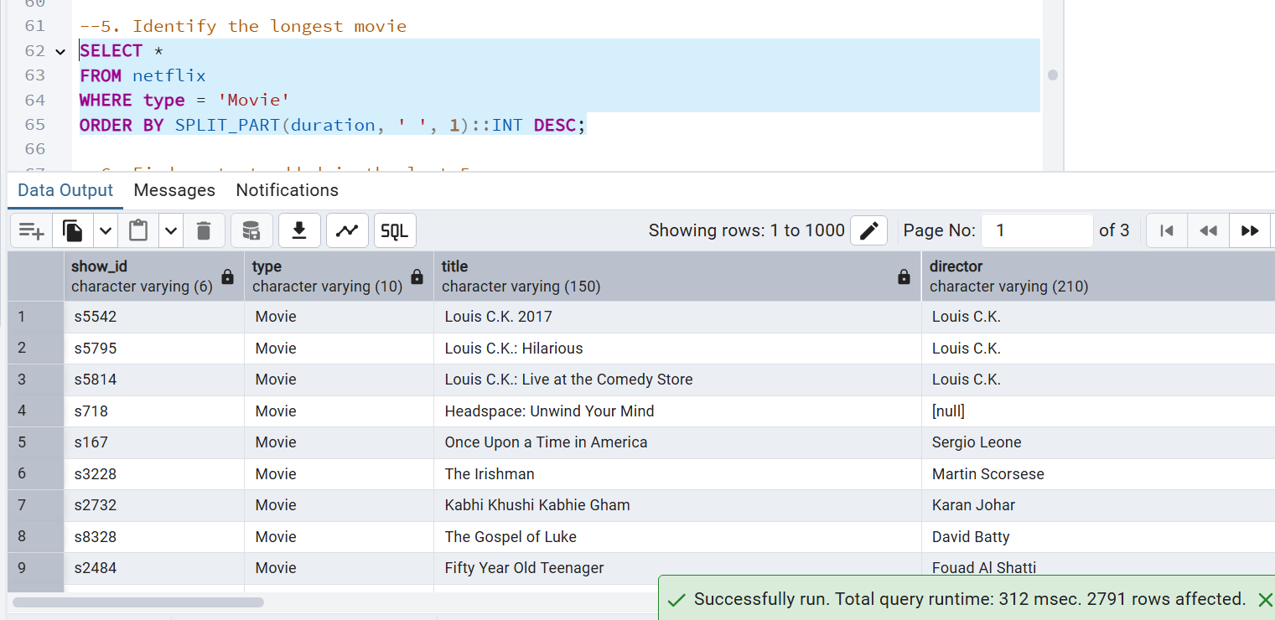
Sample Queries
--5. Identify the longest movie
SELECT *
FROM netflix
WHERE type = 'Movie'
ORDER BY SPLIT_PART(duration, ' ', 1)::INT DESC;

Slide 15
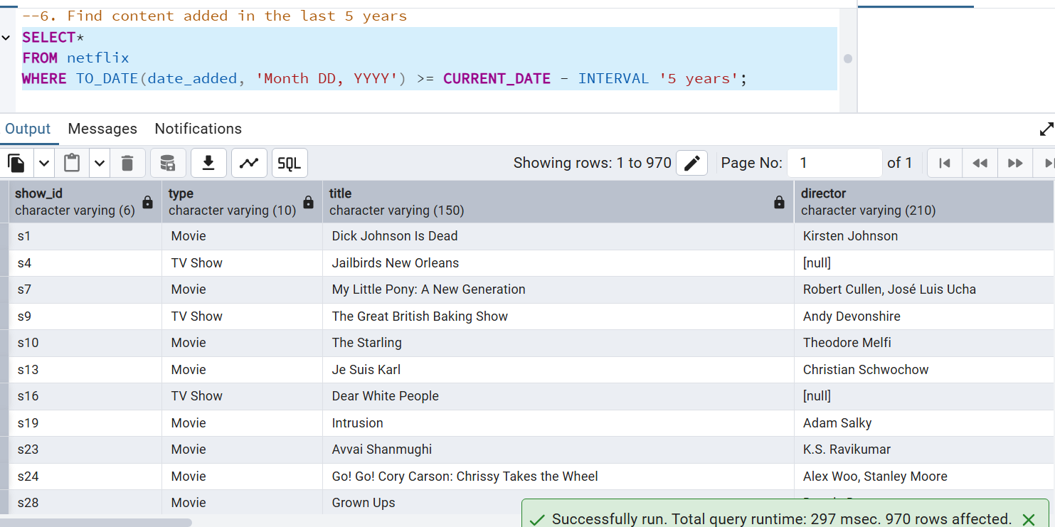
Sample Queries
--6. Find content added in the last 5 years
SELECT*
FROM netflix
WHERE TO_DATE(date_added, 'Month DD, YYYY') >= CURRENT_DATE - INTERVAL '5 years';

Slide 16
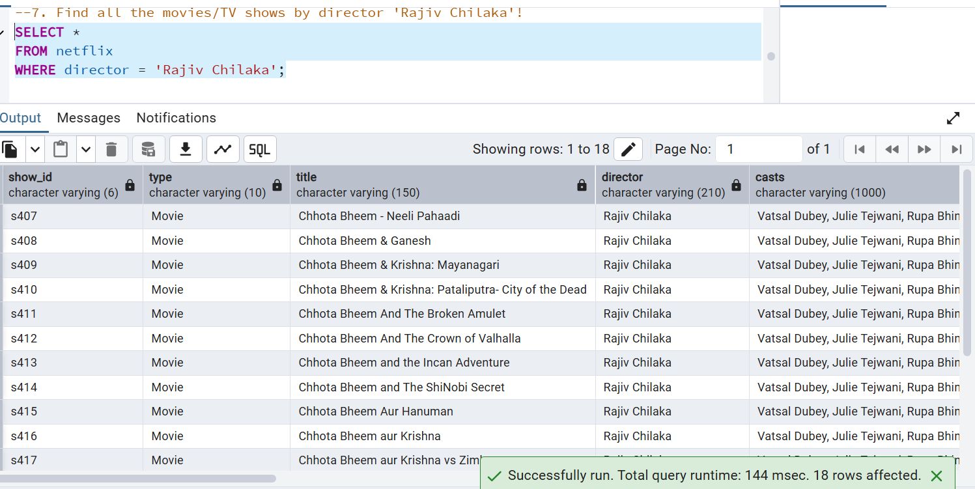
Sample Queries
--7. Find all the movies/TV shows by director 'Rajiv Chilaka'!
SELECT *
FROM netflix
WHERE director = 'Rajiv Chilaka';

Slide 17
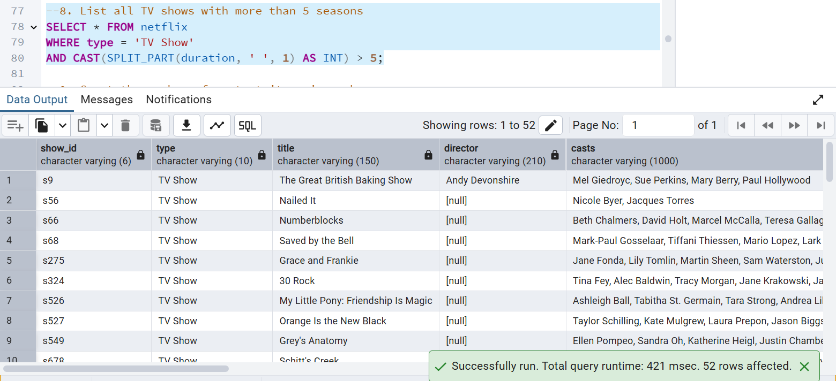
Sample Queries
--8. List all TV shows with more than 5 seasons
SELECT * FROM netflix
WHERE type = 'TV Show'
AND CAST(SPLIT_PART(duration, ' ', 1) AS INT) > 5;

Slide 18
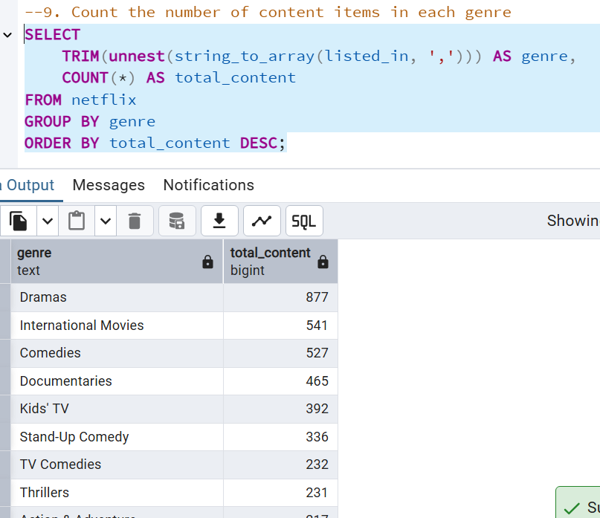
Sample Queries
--9. Count the number of content items in each genre
SELECT
TRIM(unnest(string_to_array(listed_in, ','))) AS genre,
COUNT(*) AS total_content
FROM netflix
GROUP BY genre
ORDER BY total_content DESC;

Slide 19
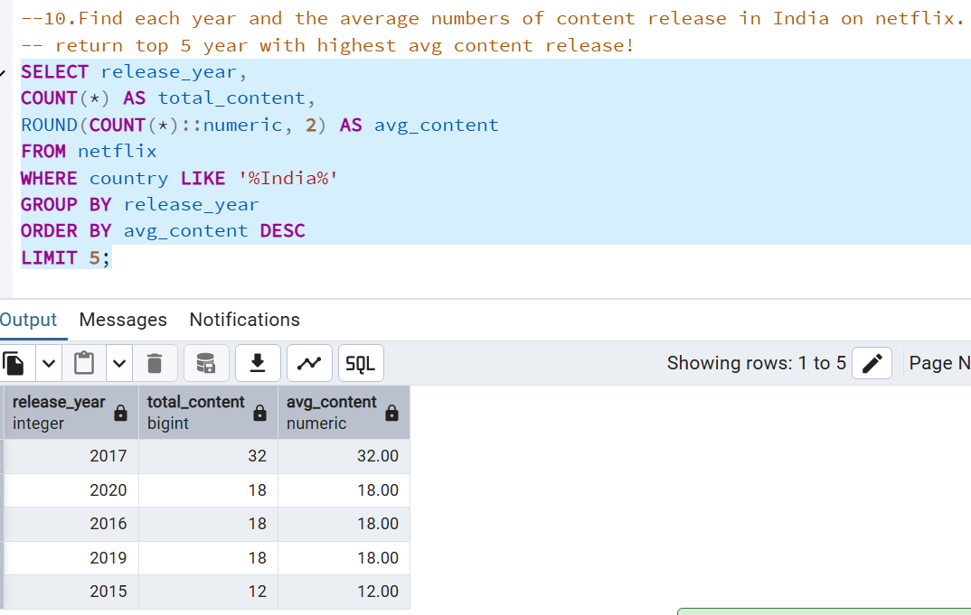
Sample Queries
--10.Find each year and the average numbers of content release in India on netflix. return top 5 year with highest avg content release!
SELECT release_year,
COUNT(*) AS total_content,
ROUND(COUNT(*)::numeric, 2) AS avg_content
FROM netflix
WHERE country LIKE '%India%'
GROUP BY release_year
ORDER BY avg_content DESC
LIMIT 5;

Slide 20
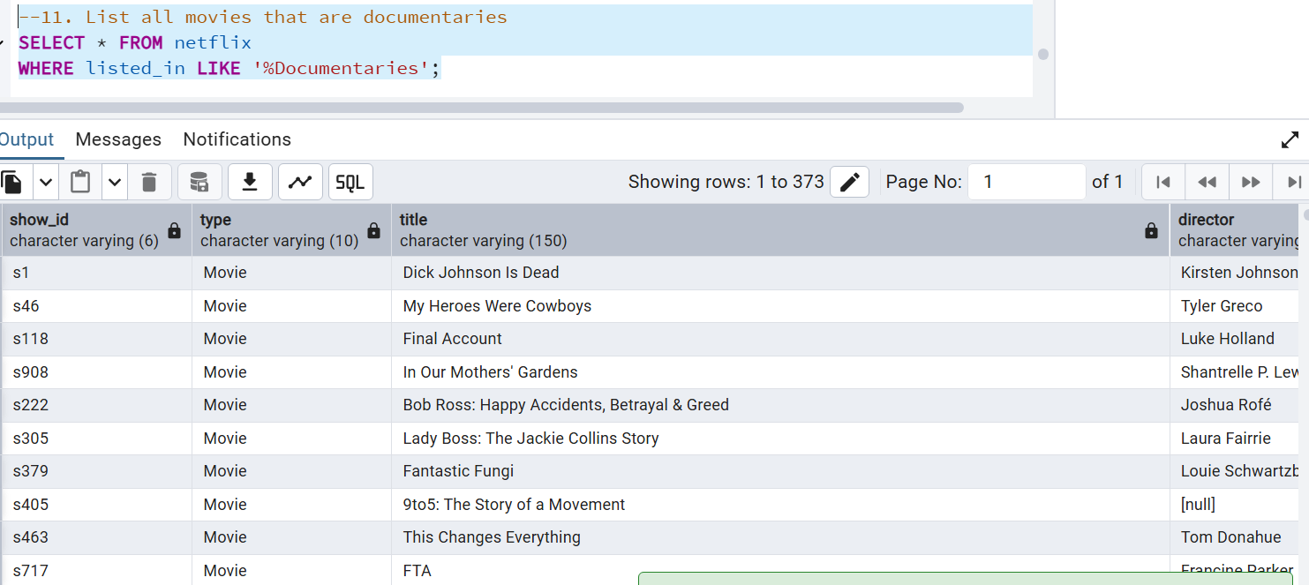
Sample Queries
--11. List all movies that are documentaries
SELECT * FROM netflix
WHERE listed_in LIKE '%Documentaries';

Slide 21
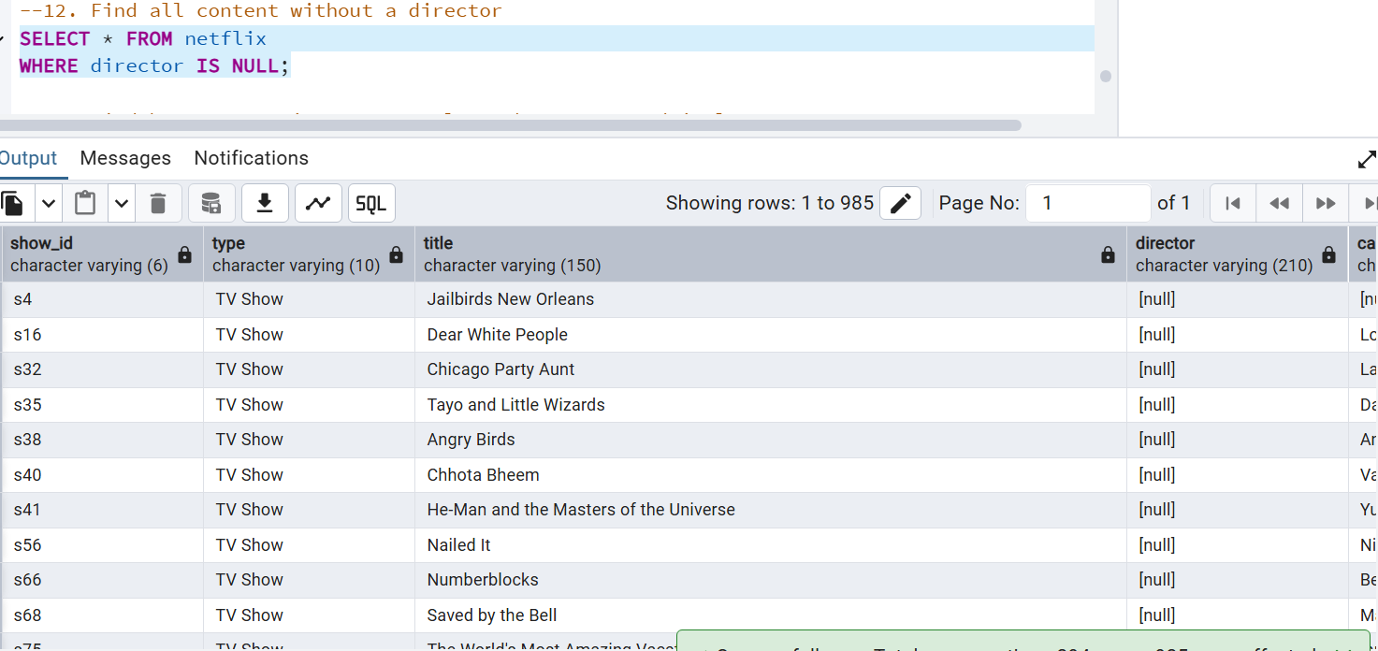
Sample Queries
--12. Find all content without a director
SELECT * FROM netflix
WHERE director IS NULL;

Slide 22
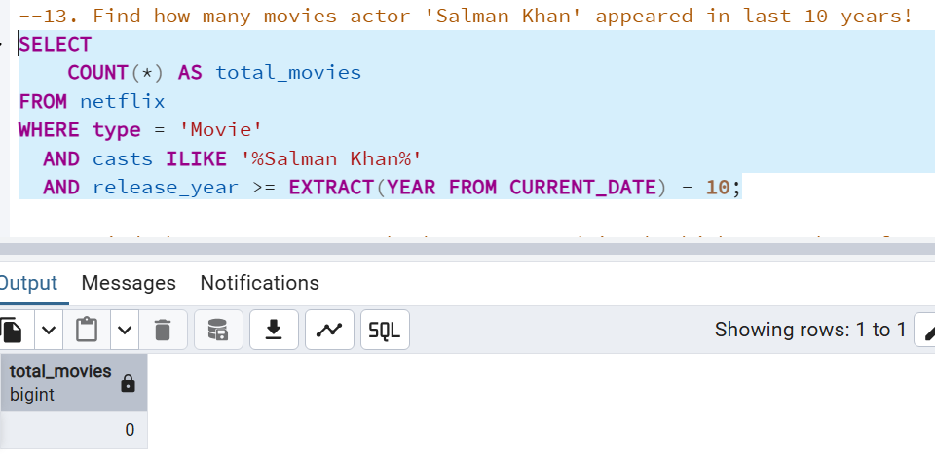
Sample Queries
--13. Find how many movies actor 'Salman Khan' appeared in last 10 years!
SELECT
COUNT(*) AS total_movies
FROM netflix
WHERE type = 'Movie'
AND casts ILIKE '%Salman Khan%'
AND release_year >= EXTRACT(YEAR FROM CURRENT_DATE) - 10;

Slide 23
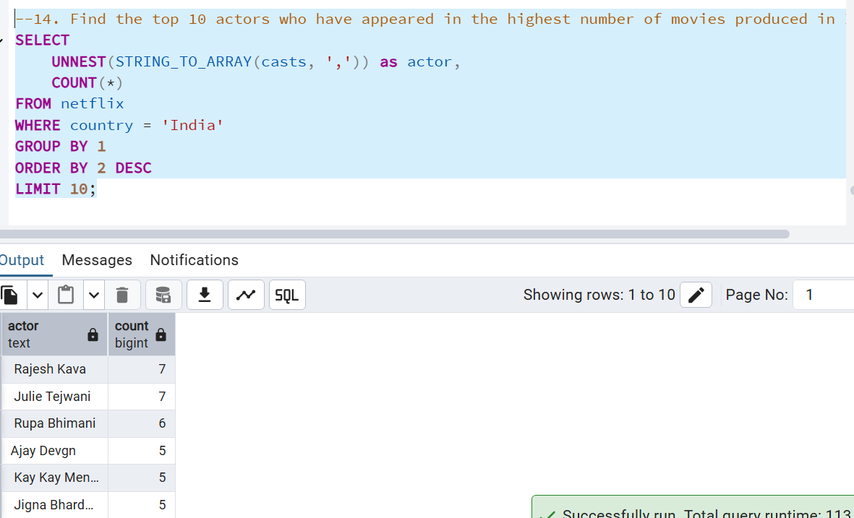
Sample Queries
--14. Find the top 10 actors who have appeared in the highest number of movies produced in India.
SELECT
UNNEST(STRING_TO_ARRAY(casts, ',')) as actor,
COUNT(*)
FROM netflix
WHERE country = 'India'
GROUP BY 1
ORDER BY 2 DESC
LIMIT 10;

Slide 24
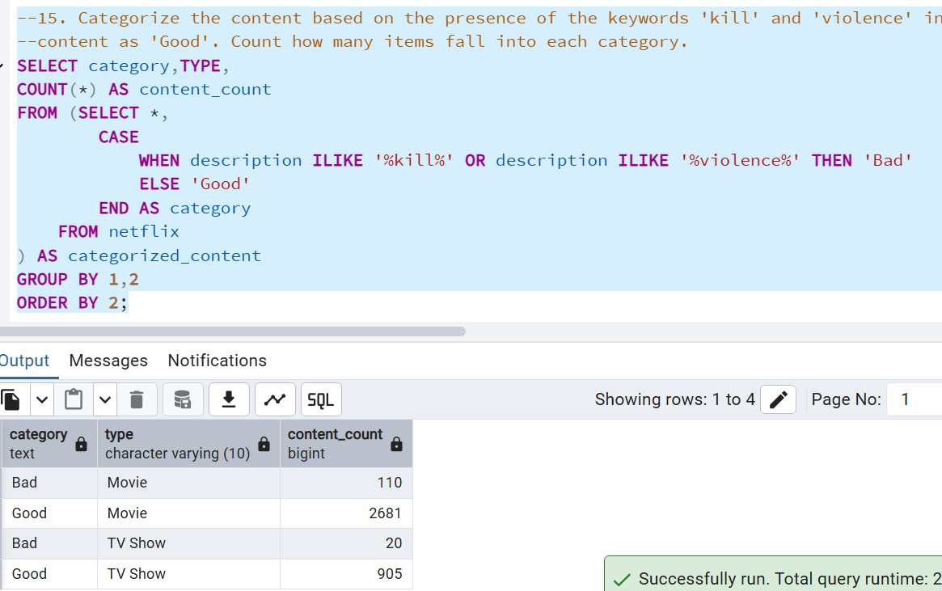
Sample Queries
SELECT category,TYPE,
COUNT(*) AS content_count
FROM (SELECT *,
CASE
WHEN description ILIKE '%kill%' OR description ILIKE '%violence%' THEN 'Bad'
ELSE 'Good'
END AS category
FROM netflix
) AS categorized_content
GROUP BY 1,2
ORDER BY 2;

Slide 25
Skills Gained
SQL wrangling with PostgreSQL
Using ILIKE, UNNEST, SPLIT_PART
Data aggregation & ranking
Querying business-focused problems
Entertainment trend analysis

Slide 26

Why This Project Matters
02
Can extend to Power BI/Tableau dashboards
01
Simulates real streaming analytics
03
Perfect for GitHub/LinkedIn portfolio
03
Proof of SQL skills on real dataset
03
Strong interview
showcase project

Slide 27
Conclusion
Analyzed Netflix dataset with 15+ SQL queries
S
W
Movies vs TV Shows
Actors & Directors
O
T
Countries & Genres
Ratings & Trends
Sensitive content categorization

Slide 28
Thank You!
Every great presentation is complete with a great audience
— and that’s you!

